Slide 1
Welcome to Horace Mann Elementary
Aug. 22, 2023

Slide 2
Welcome to RCAS – Specifically HM!
Rapid City Area Schools strengthens community through, education, communication and appreciation.

Slide 3
Horace Mann Mission
Together with students, staff and community, we learn, we lead, and we are family.
We are one!
#HMSTRONG

Slide 4
2022-2023 CELEBRATIONS
HM Leader in Me School. The LIM framework provides us the knowledge, tools and resources to establish a healthy school Culture, Strong Academics and Leadership for all.
We learn about the 8 Habits of Highly Effective People, learn and apply the 8 habits through the intentional integration into content areas, daily lessons, school projects and events and our 3-5 graders apply the habits by taking a leadership role on our HM Student Action Teams!
There are over 7,000 LIM schools worldwide and less than 10% of those receive LIGHTHOUSE Certification. We are proud to announce that Horace Mann Elementary earned this certification in the spring of 2023!

Slide 5
2022 – 2023 CELEBRATIONS CONTINUED…
K-2 Grade MATH GROWTH
GOAL: 72% of K-2nd grade students attending HM will meet their growth projection as measured by the end of the year Acadience Math Assessment.
K = 85%
1st = 55%
2nd = 83%
Combined Total =
74% WE MET OUR GROWTH GOAL
3-5th Grade MATH GROWTH
GOAL: 60% of 3-5th grade students attending HM will meet their projected RIT score, as measured by the end of the year MAP Growth Assessment.
3rd = 69%
4th = 61%
5th = 62%
Combined Total =
64% WE MET OUR GROWTH GOAL

Slide 6
2022-2023 Reading/ELA Data
K-2 Grade READING
GROWTH GOAL: 61% of K-2 students attending HM will achieve average or above average growth as measured by the end of the year Acadience READING Assessment,
K = 73%
1st = 36%
2nd = 61%
Combined Total =
57% WE MISSED OUR GOAL by 4%
3-5th Grade ELA
GROWTH GOAL: 60% of 3-5th grade students attending HM will meet their projected RIT score, as measured by the end of the year MAP ELA Growth Assessment.
3rd = 42%
4th = 38%
5th = 62%
Combined Total =
47% WE MISSED OUR GOAL by 13%

Slide 7
Notes:
How can you help?

Slide 8
HOW do I support m y HM School Family’s culture academic success & leadership skills
Get your child to school and on time every day! (calendar – handout – days off)
Support your child’s academic by supporting with practice at home
Counting to 100, starting at any number
Addition and Subtraction Facts within 5
Practice writing and reading sight words
(ALL K students will know how to read and spell at least 47 words before moving to 1st grade)
Stay connected to CLASS DOJO – Turn on your notifications so you get the information and stay connected to what is happening at school
Attend HM family events & Student-Led Conferences

Slide 9
Why is attendance important?
Did you know?
Missing school one day per week means missing one full year of instruction for every four years that they are in school.
Students who miss school (2 days or more per month) are SIGNIFICANTLY less likely to graduate
Kindergarten students who have good attendance, continue to have good attendance throughout school. The same goes true for the opposite
By 6th grade poor attendance is the #1 indicator of whether or not someone will drop out of school
Notes:
The only way we can educate our students is if they are here. We need your help and a commitment to get your child to school. I will tell you that at HM, if there are factors that are making it difficult for you to get your child to school you just need to call. We will do every thing we can do to help. Fix cars, give rides, connect families so they can carpool. Open lines of communication are essential. I stand here today and promise that I will do everything in my power to help you. It means that much. Lets’ read what happens when attendance isn’t so great…

Slide 10
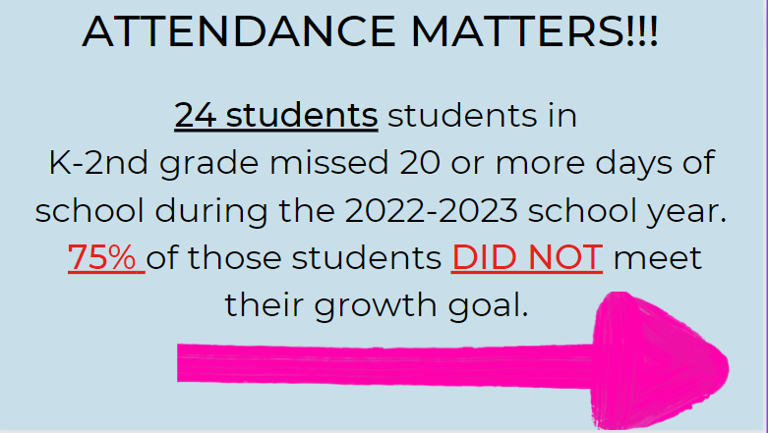

Slide 12
At HM, We SET and Achieve WILDLY IMPORTANT GOALS (WIG)
A FOCUS on MATH
Kindergarten
Count to 100, starting at any number
Know ALL addition and subtraction facts (facile) within 5
1st Grade
Know ALL addition and subtraction facts (facile) within 10
2nd Grade
Know ALL addition and subtraction facts (facile) within 20
3rd – 5th Grade
Know ALL multiplication and division facts (facile) 0x0 – 12x12

Slide 13
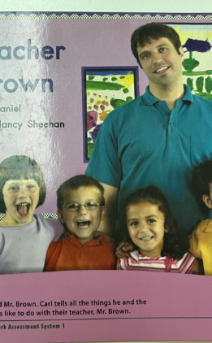
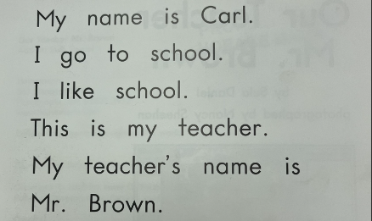
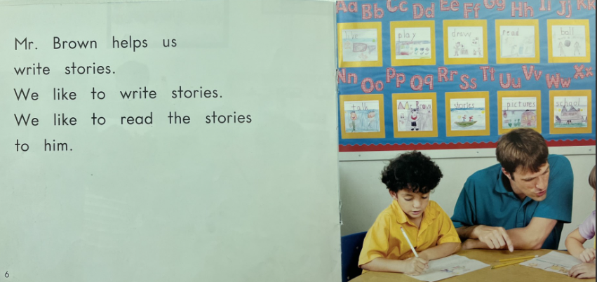
What Books Does my Child need to read in Kindergarten?

Slide 14
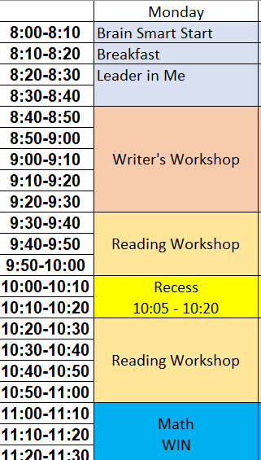
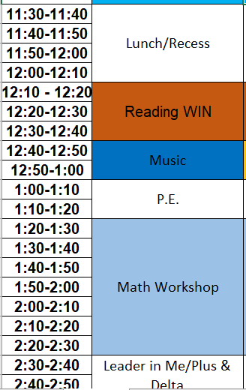
A typical day for Kindergarten Students

Slide 15
QUESTIONS

