Slide 1

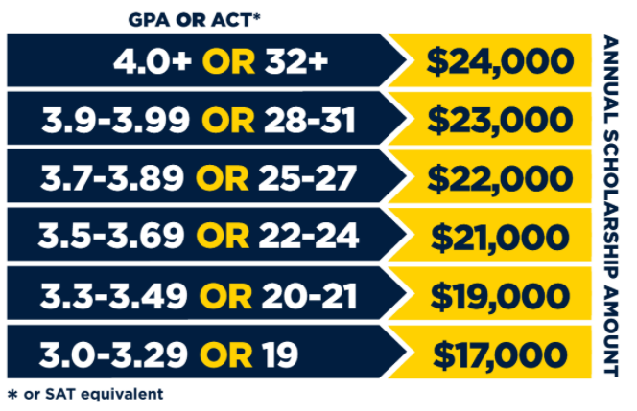
Free application: augie.edu/apply
Apply
Test-optional application.
H.S. Transcript required, Test Scores Optional
Preferred applicants 3.0+ GPA.
Application requirements
File the FAFSA.
Tour campus with a student.
Submit your enrollment deposit.
Move-in day!
Once Accepted
Financial Aid
Scholarships
Tuition
Placement/Job Info
Academic, talent, and need-based aid.
New: SDOS Match
Your GPA or test scores (whichever is higher) determine your annual scholarship.
www.augie.edu/cost
Experiential learning guarantee. Ranked #2 in the nation for Employability
~Zippia.com
100% of students receive scholarships

Slide 2


Apply
  Apply online at http://bhsu.edu/apply
-- 2 Campus Locations:
Spearfish & Rapid City
-- Enrollment: 3,608
-- Top Programs:
Business
Education/Teaching
Sciences & Social Sciences
Visit Campus
Majors & Academic Programs
Dual Credit
admissions@bhsu.edu | 605-642-6343
www.bhsu.edu
-- $20 Application Fee
-- High School Transcript
-- ACT/SAT Scores (optional)
Application requirements
  Apply for scholarships & submit FAFSA (optional)
  Submit $100 Housing Deposit
  Admitted Student Checklist at www.bhsu.edu/Admissions/Accepted-Students
After
Acceptance
Financial Aid
Scholarships
Tuition
Placement/Job Info
Apply for BHSU Scholarships online: www.bhsu.edu/scholarships
View rates and
estimate costs online.
BHSU Career Development Center
FAFSA Code: 003459

Slide 3


Application & Admission Process
Apply
Apply at dsu.edu/apply
Located: Madison, SD
Enrollment: 3186
Technology infused classes
In-demand programs
Nationally known technology programs
Visit Campus
Majors
Dual Credit
admissions@dsu.edu | 605-256-5139
dsu.edu
- $20 Application Fee
- High School Transcript
- ACT/SAT Scores (optional)
Application requirements
- Activate DSU Accounts
- Submit Immunization Form, and Housing & Dining
Contracts
- Complete Financial Aid & Scholarships
(DSU General Scholarship deadline March 1st)
- Register for Classes
Review New Student Checklist
Acceptance
Financial Aid
Scholarships
Tuition
Placement/Job Info
FAFSA Code:
003463
Net Price Calculator
DSU Champion
21+ ACT and 3.0 GPA
Dual Credit
Horatio Alger Denny Sanford
Tuition and Fees
Cost Sheet
Laptop Included!
99% within 6 mos
100% in all Education
& Business Programs

Slide 4


Apply
  Submit FREE Online Application
900 Students Mitchell, SD
Largest programs: Nursing, Business, and Education
Masters in Athletic Training Program
Business Ag & Construction Management offered in partnership with Mitchell Tech
Admissions@dwu.edu
605-995-2650
  High school & college transcripts
  ACT/SAT Test Scores are NOT required (see test-optional info)
Application requirements
  Complete the FAFSA
  Submit $200 Enrollment Deposit
  Complete Online Housing Form
  Sign up to Register for Classes
Once Accepted
Financial Aid
Scholarships
Tuition
Placement/Job Info
The Net Price Calculator will give the best view of out-of-pocket costs.
DWU FAFSA Code: 003461
100% of students receive scholarships. Scholarship Info
DWU Tuition and Fees
96% overall job placement
More DWU outcomes

Slide 5

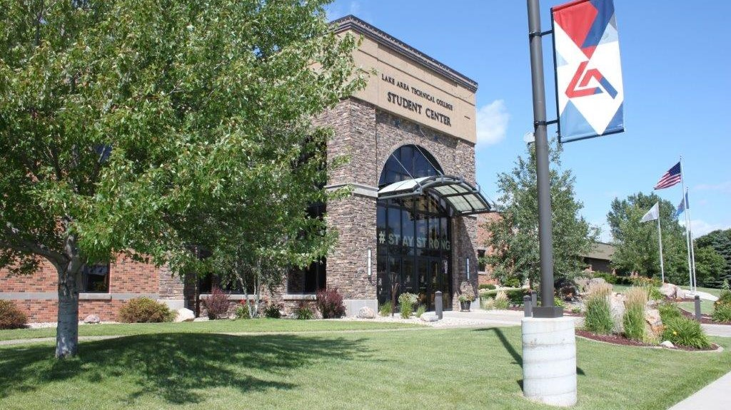


  Apply online
https://www.lakeareatech.edu/getting-started/apply-now/
There are a number of great reasons to attend Lake Area Technical College:
99% Graduate Placement Rate
$450,000+ in Scholarships Available
32 Career Programs
12 Online E-Degrees
22,000+ Graduates
Numerous awards including 2017 Aspen Prize Winner for Best Two-Year College in the Nation
HANDS-ON Education with the most advanced equipment in the field!
Faculty & Staff that CARE about your success!
Great career options-Our students are IN DEMAND!
Have Questions? Contact Us!
Apply
  High School transcript
  ACT or Accuplacer Score
Application
Requirements
  Review Acceptance Packet
  Complete FAFSA & Scholarship applications
  Lock in Housing
  Attend Summer Orientation- Get to know LATC
Once
Accepted
Financial Aid
Scholarships
Tuition
Placement/Job Info
LATC Code:
005309
Priority Date:
April 1st 2022
Build Dakota Full-Ride & Foundation Scholarships available!
Due March 31st, 2022
Affordable Tuition:
$124 per credit!
99%
graduate placement rate
Active Hyperlinks above

Slide 6
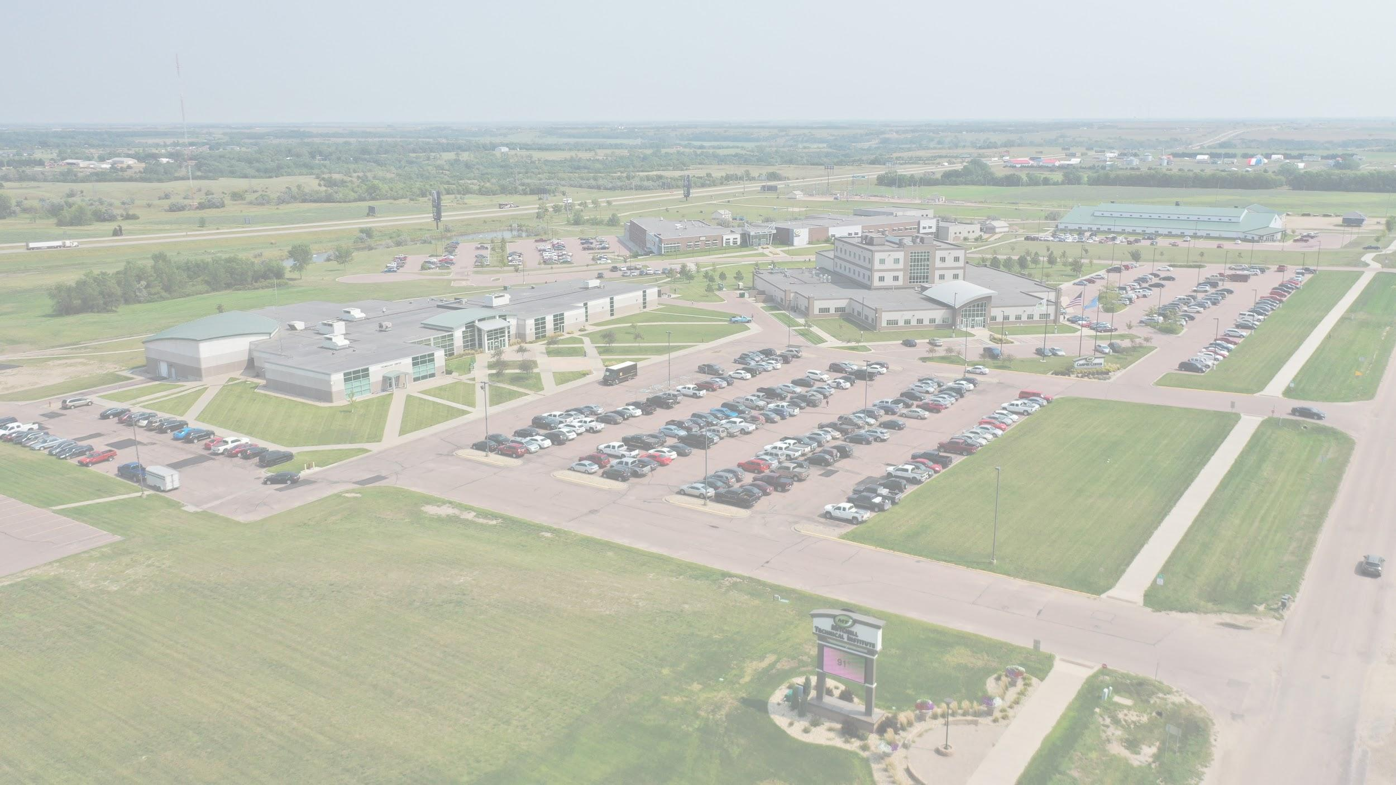

Application Process
Apply for free: mitchelltech.edu/apply
We have an outstanding reputation for providing some of the most in-demand programs in the nation!
View a complete list of majors.
We offer in-person, group, and virtual visits. Learn more.
Dual Credit opportunities are offered for students both on campus and online. Learn more.
Apply
  High School Transcript or GED Scores
  College Transcript
  Placement Test Scores (ACT or ACCUPLACER)
  Note - some programs will require additional admissions items.
Application requirements
Programs We Offer - Mitchell Technical College
  Complete FAFSA
  Complete Scholarship Application
Acceptance
Financial Aid
Scholarships
Tuition
Placement/Job Info
Mitchell Tech’s School Code: 008284
Click here for more info.
Jan. 1st - March 31st
Partial and Full-ride Scholarships Available!
Over 320 scholarships offered annually!
View a breakdown of costs here!
99.5% job placement rate within 6 months!

Slide 7

Application Process
  Fill out our FREE Application
  Be accepted based off self reported GPA and ACT/SAT.
Mount Marty University is the only traditional : Catholic Benedictine University in the state of South Dakota.
500 Undergraduate Students on the Yankton Campus
Brand new Fieldhouse and Residence Hall
Campus Life Opportunities
Contact the Admissions Office with any questions at 605-668-1545 or admissions@mountmarty.edu
Apply
Visit The Mount
Take a Virtual Tour
Ask about our special visit days
Visit Us
  Fill out FAFSA starting Oct 1st.
  Send Transcripts/Test Scores
  Attend Scholarship Days
After Acceptance
Financial Aid
Scholarships
Tuition
Placement/Job Info
FAFSA Code:003465
100% of students receive scholarships & grant aid offers.
Learn more about Tuition, Scholarships, and Financial Aid
96% Placement rate after graduation.

Slide 8


Application Process
  Fill out online application
South Dakota Mines continues to earn awards for outstanding academic programs and affordability of an advanced STEM education https://www.sdsmt.edu/About/Points-of-Pride/
Visit South Dakota Mines to get a feel for our collaborative, innovative campus community. www.sdsmt.edu/visit
If you have any questions, Ashli Maddox is happy to help! ashli.maddox@sdsmt.edu
Apply
  SAT or ACT Scores
  High School Transcripts
  View all requirements
Application requirements
Students who meet minimum requirements and prove math readiness will be accepted. Your admissions counselor will work with you on any supplemental materials needed to process your application.
Acceptance
Financial Aid
Scholarships
Tuition
Placement/Job Info
Students MUST be accepted before January 15th. Scholarships are based on ACT (or SAT) scores AND high school GPA, https://www.sdsmt.edu/FinAid/Scholarships/
Estimated cost for SD residents: $22,310
(includes fees, laptop program, room and board)
https://www.sdsmt.edu/Admissions/Tuition-and-Fees/
*97% Job Placement *Average starting salary $66,156
https://www.sdsmt.edu/Campus-Life/Career-Center/Internships-and-Co-ops/
FAFSA code: 003470
https://www.sdsmt.edu/FinAid/

Slide 9

Application Process
Please adhere to slide forat but add school logo, and background of your choice
Located in Aberdeen, SD
New Regional Science Center
Suite style & traditional style residence halls recently built
New football stadium to open Fall 2021
Campus tours available over Zoom or in person
Contact us at admissions@northern.edu or 605-626-2544
Apply
  Fill out online application
Application requirements
  ACT score of 18 or above (not required) OR
  2.6 GPA or higher OR
  Rank in top 60% of class
Once Accepted
  FIll out FAFSA
  Complete housing app
  Register for classes
Financial Aid
Scholarships
Tuition
Placement/Job Info
Northern State FAFSA code:
003466
WolfPact Scholarship starts with 3.25 GPA & 20 ACT.
Available Scholarships
Total estimated costs for SD residents including tuition, room, meal plan: $17,375
96% Job placement & graduate reports

Slide 10


paulmitchell.edu/rapidcity/
online-application
APPLY
START DATES:
Cosmetology: April, June, September, November
Nails: March, June, November
Esthetics: April, July, October
Massage Therapy: April, July, November
ENROLLMENT TEAM:
Call: 605.718.6931
Text: 605.205.7529
Admissions@rapidcity.paulmitchell.edu
REQUEST MORE INFO:
paulmitchell.edu/rapidcity/request-enrollment-information
  2 Photos
  GED/High School Diploma
  Driver’s License/Birth Certificate
  Application Fee
  Personal Interview
APPLICATION REQUIREMENTS
paulmitchell.edu/rapidcity/request-a-tour
REQUEST A TOUR
FINANCIAL AID
SCHOLARSHIPS
TUITION
LICENSURE
paulmitchell.edu/
rapidcity/financial-aid/
scholarships
Cosmetology: $16,135
Nails: $4,300
Esthetics: $9,500
Massage Therapy: $10,000
*tuition prices include application fee, technical kit, and books
93.75 %
Licensure Rate
FAFSA Code: 016231

Slide 11

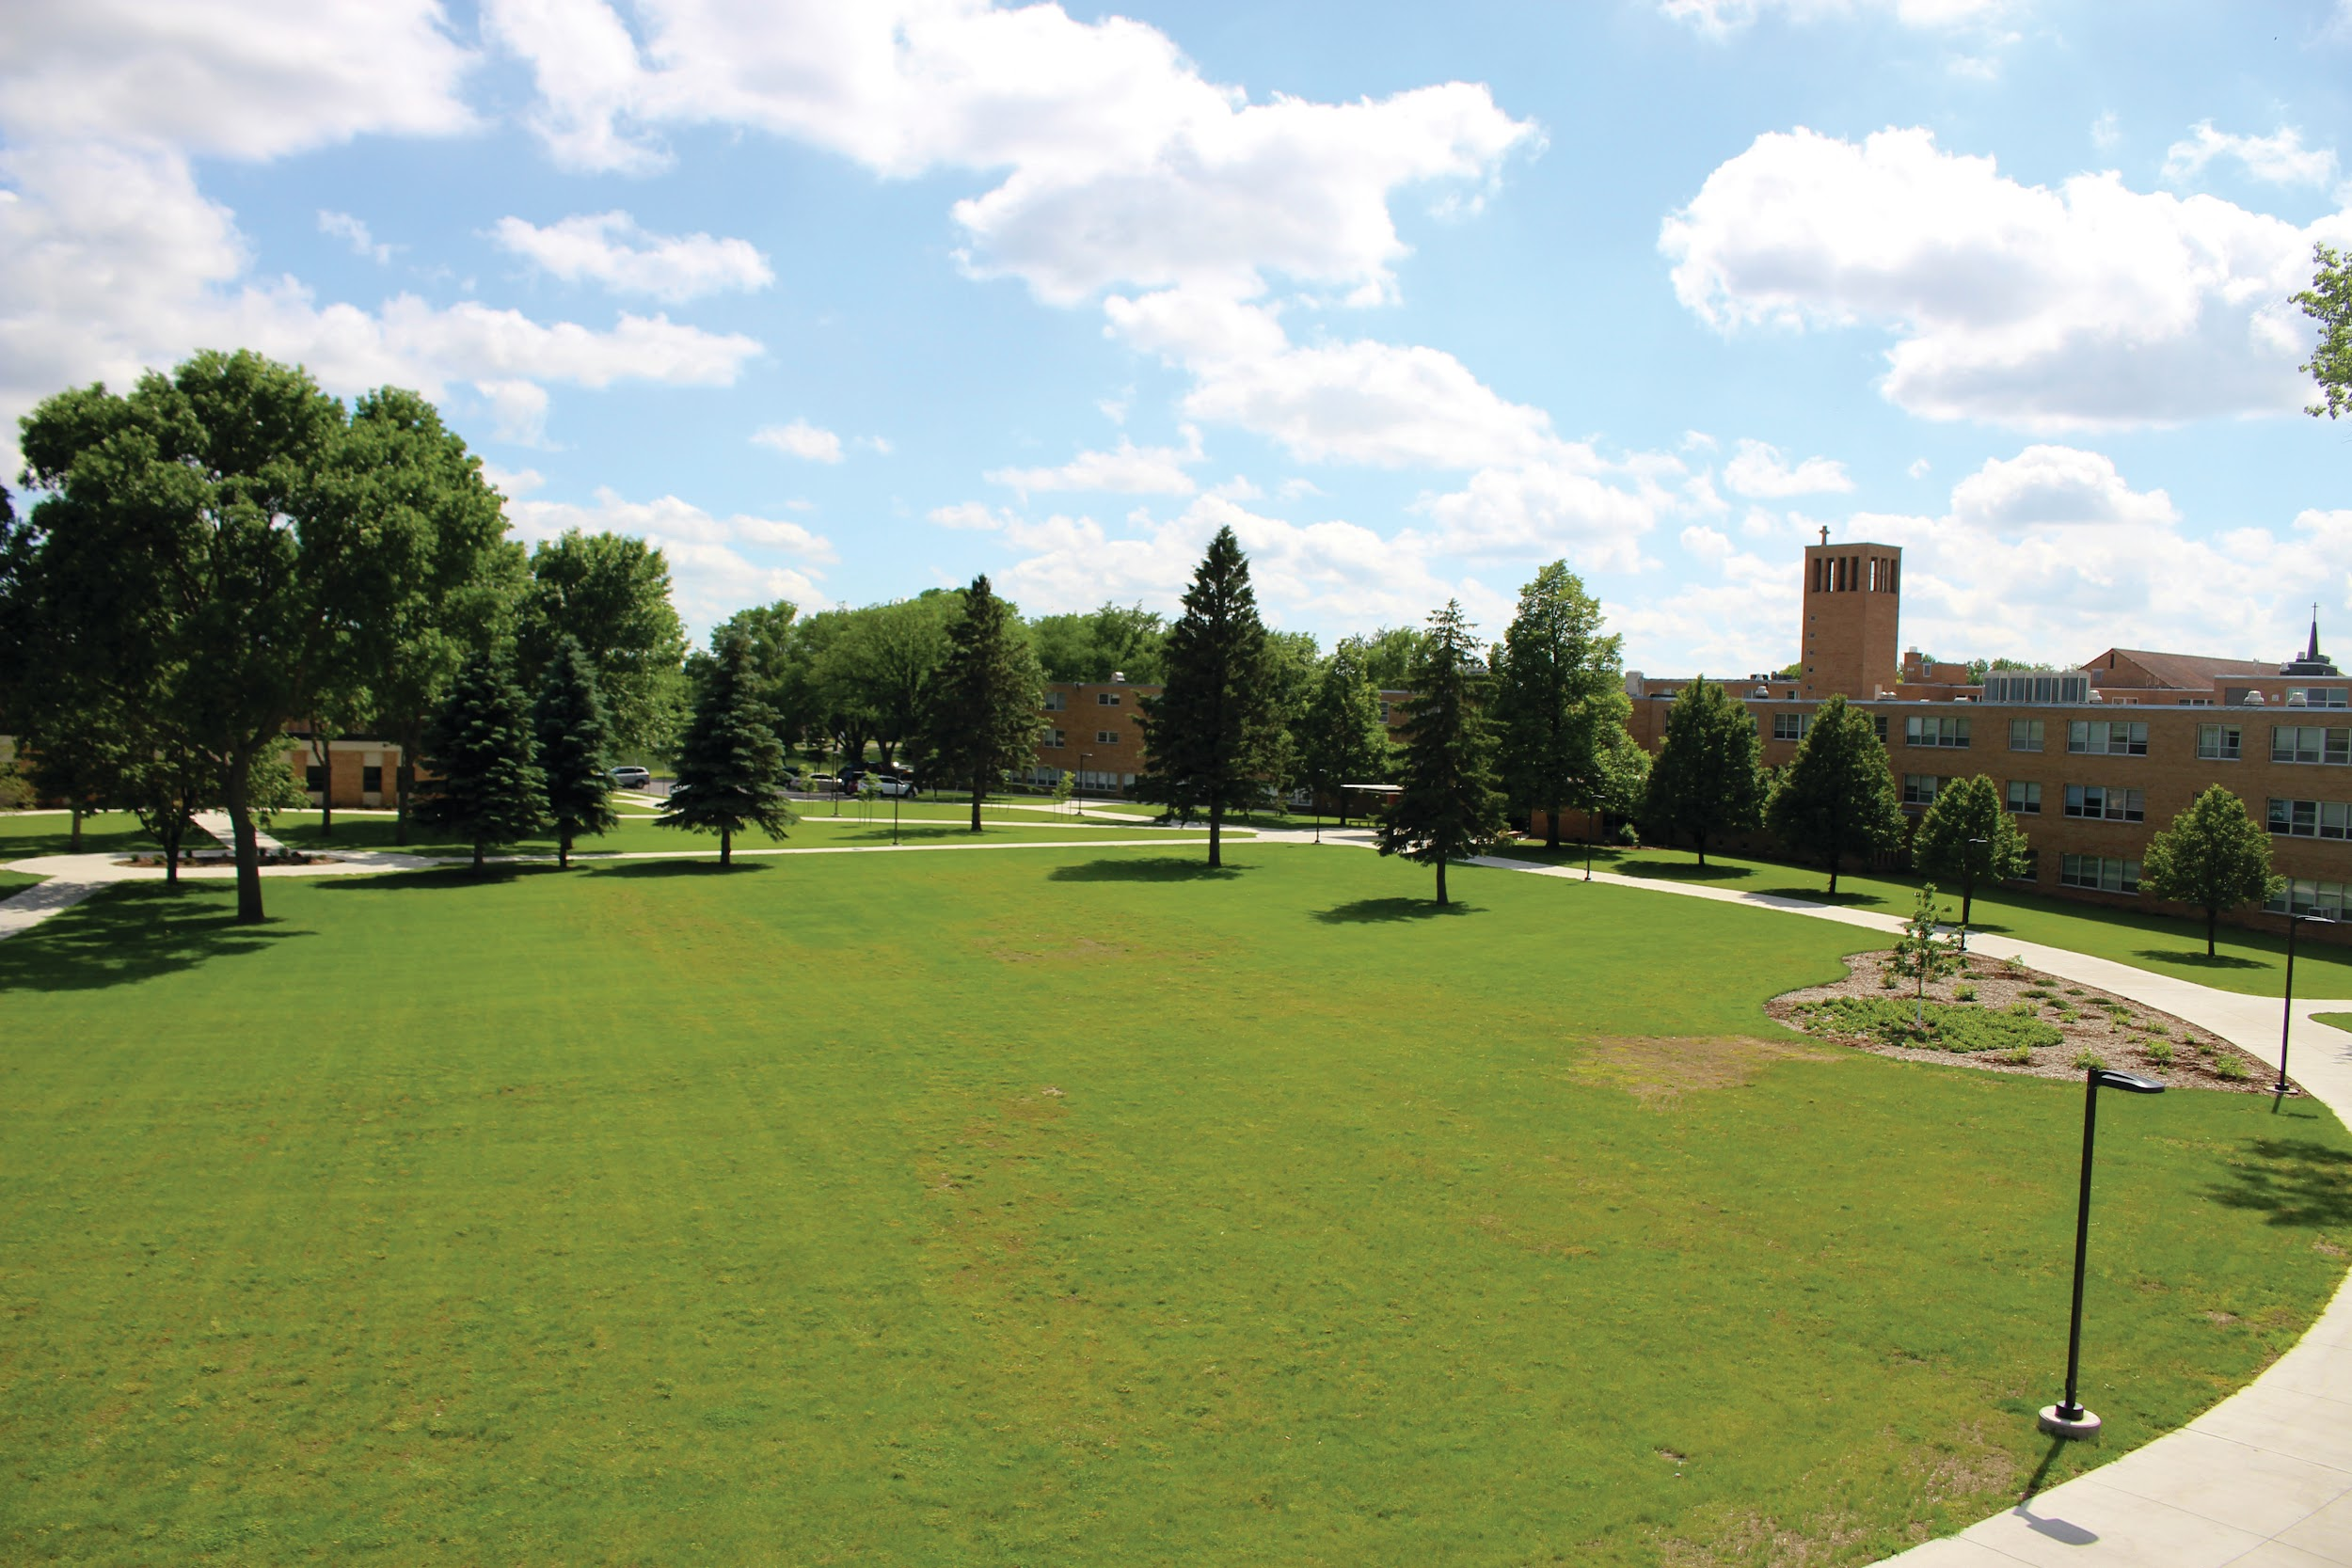

Application Process
  presentation.edu/apply
Small campus, family and community atmosphere. 350 students on campus, 300 students online.
Tour campus with our virtual tour!
Cozy suites, get your own room.
20+ Academic programs, very career focused and customizable.
Chat with us! admit@presentation.edu 605.229.8492 www.presentation.edu
Apply
  High School Transcript
  ACT/SAT scores (optional)
  App Fee Waiver Code: HOME
Application requirements
  File the FAFSA
  Submit $100 tuition deposit
  Apply for housing
  Register for classes
Acceptance
Financial Aid
Scholarships
Tuition
Placement/Job Info
School code: 003467
90%+ of PC students receive Financial Aid
Up to $11,500 /year Academic Scholarships
Many more at: presentation.edu/tuition-aid/scholarships
Tuition: $21,626
Housing: $10,430
96% of graduates are in grad school or working in their field within 6 months of graduation.

Slide 12
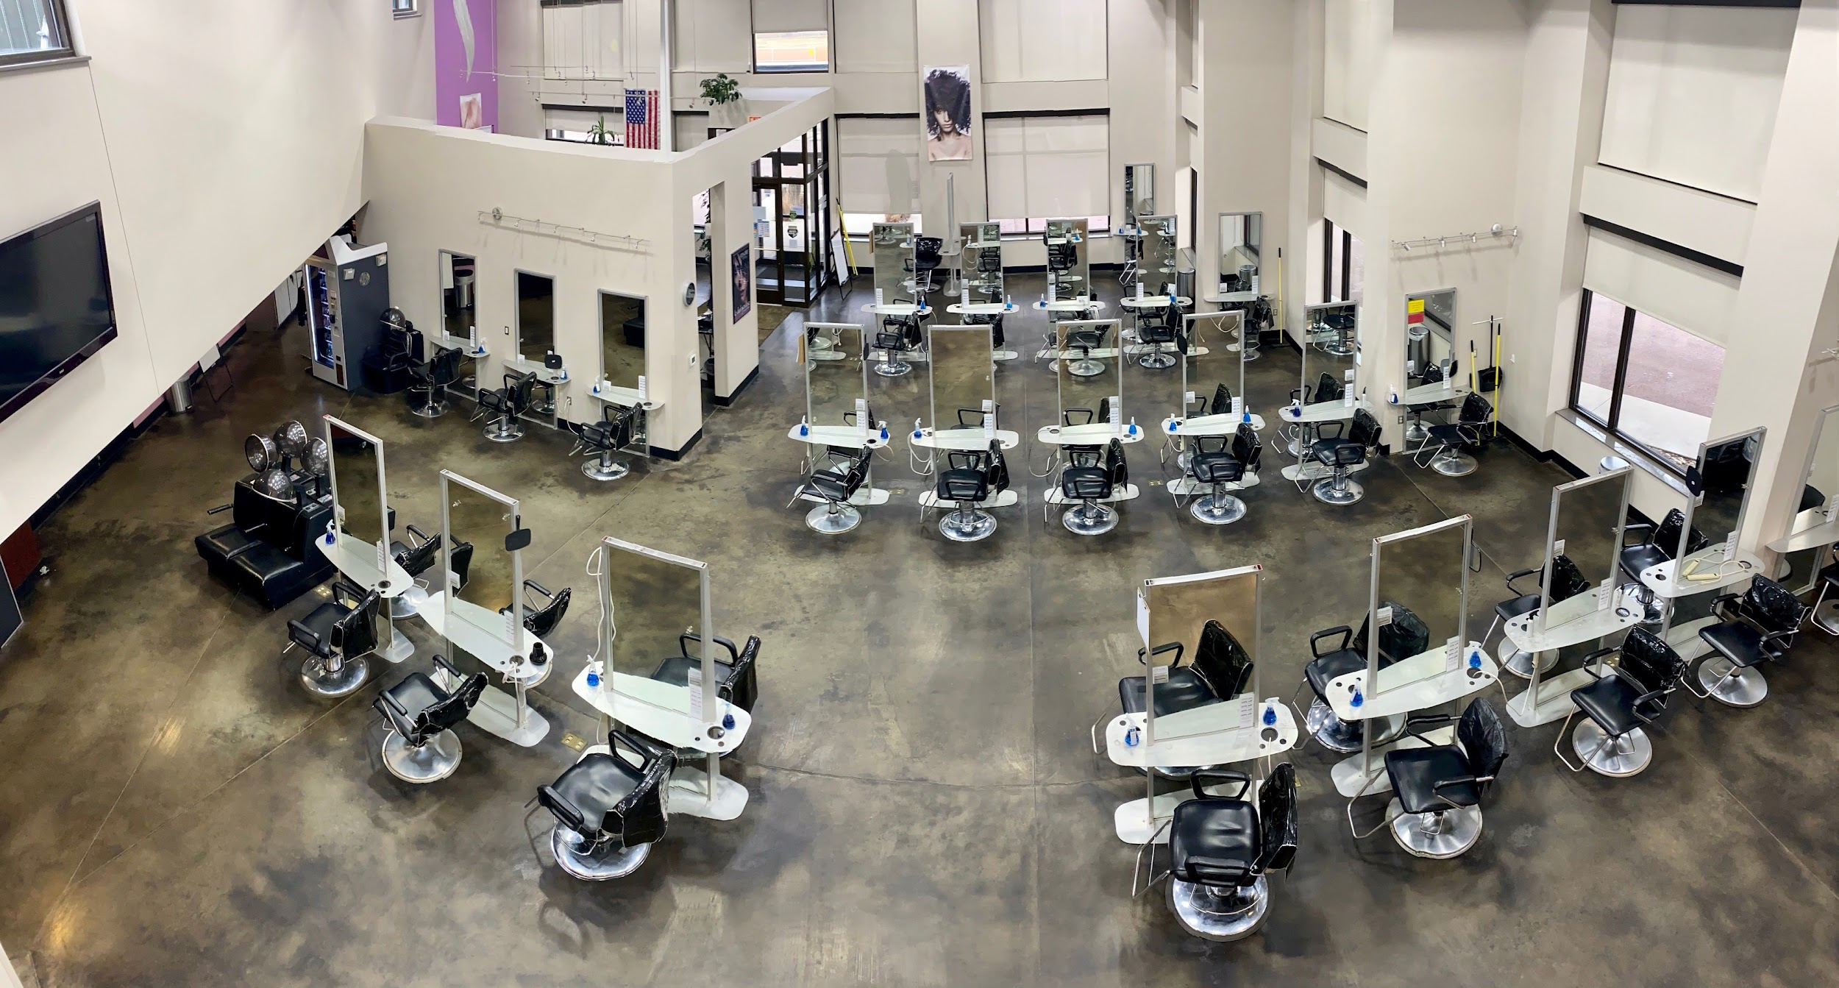

Application Process
Apply
Apply in person or visit our website: https://stewartschool.com/application/
For over 60 years Stewart School has focused on developing student real-world salon/spa skills in a culture built on teamwork, creativity, passion, and
business success. Located in Sioux Falls!
Our Accreditor, ACCSC, has named Stewart School a "School of Excellence" during our last two accreditation renewals.
*Start with a school visit! Text 215-1637 to schedule or to request more info!
  Come for a school visit. Zoom visits are available upon request!
  $50 application fee
  Proof of graduation or GED
  Submit copy of driver’s license
Application requirements
  Submit the above requirements & complete formal Interview with Admissions Director
Acceptance
Financial Aid
Scholarships
Tuition
Placement Info
FAFSA CODE: 010138
Up to $2,500 for Cosmetology!
Ask our Admissions
Director for details.
*current tuition rates for 2021
Cosmetology $14,808
Massage Therapy $8,414
Esthetics $7,988
Nail Tech $3,035
https://stewartschool.com/files/2020/11/ACCSC_Annual_Report_Rates_2020.pdf

Slide 13

Application Process & Admissions Information
SDSU.Admissions@sdstate.edu
(800) 952-3541 / (605) 688-4121
  Apply at sdstate.edu/apply
SDSU is a premier land-grant university recognized for high value, innovation and bold impact.
EXPLORE 200+ areas of study
Schedule your campus or virtual visit NOW!
High School Dual Credit Information HERE
Apply
  $20 Application Fee
  High School Transcript
  ACT/SAT Scores (optional)
Application requirements
  Activate MyState
  Apply for Housing
  Scholarship Priority Date: Dec 15
  File FAFSA
Acceptance
Financial Aid
Scholarships
Tuition
Placement/Job Info
FAFSA Code: 003471
SDSU Financial Aid Step by Step
Dual Credit Scholarships
Jckrabbit Guarantee
(Test Score Optional)a
Undergraduate Cost Estimate
97% of grads said they received a high quality of education!

Slide 14


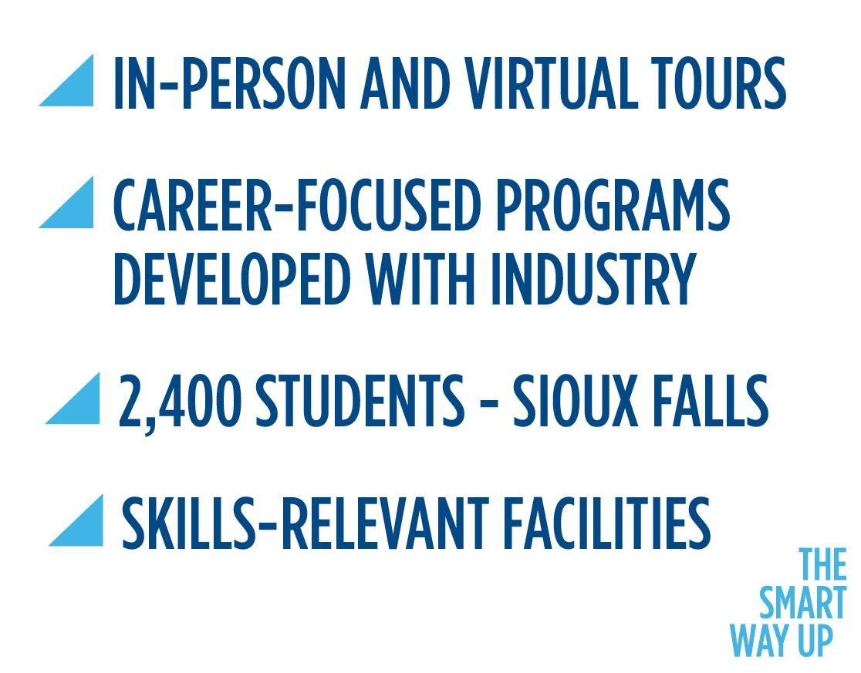
Application Process
Apply
  Submit free application.
  High school & college transcripts
  ACT/SAT may not be required, vary on program
Application requirements
  Fill out the FAFSA.
  Apply for scholarships.
  Apply for housing.
In general, follow our Accepted Student Guide.
Once Accepted
Financial Aid
Scholarships
Tuition
Placement/Job Info
FAFSA code:
008285
Jan 1 - March 31
CTE, Foundation, and full-ride Build Dakota Scholarships!
Estimated:
1 year Diploma = $9,000
2 year AAS = $16,000
View more details.
98% placement of 2020 grads!

Slide 15

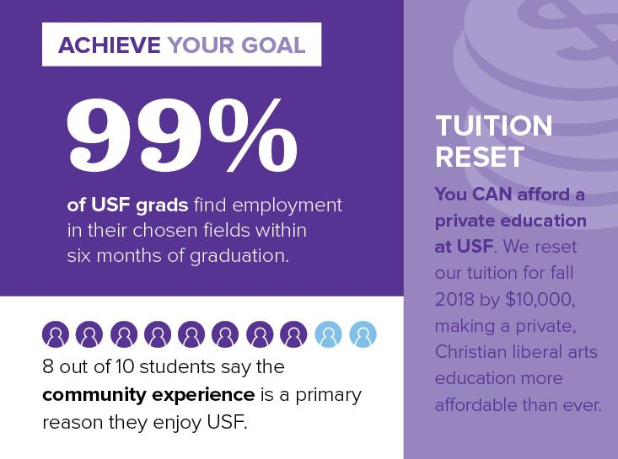
Free application, no essay!
www.usiouxfalls.edu/apply
Apply
High School Transcript
(ACT/SAT Optional)
Application Requirements
  Visit Campus (free t-shirt!)
  Submit FAFSA
  Check out our
Accepted Students Checklist!
Once Accepted
Financial Aid
Scholarships
Tuition
Placement/Job Info
USF offers academic, athletic, fine arts, and other University scholarships.
99% placement within 6 months of graduation & within students’ career field.
100% of first-time, full-time freshmen receive financial aid.
Check out USF’s Tuition & Costs!

Slide 16






Application Process
Apply
  Apply online at usd.edu/apply
USD is a big-time university with a small-college feel. Explore your interests, find your community and set yourself up for success as a Coyote.
  High School Transcript
  $20 Application Fee
  ACT/SAT Scores (optional)
200+ academic programs
Degree options in Vermillion, Sioux Falls and online
Personalized campus visits
80+ dual credit courses
Application Requirements
  Complete the FAFSA (optional)
  Submit $100 Housing Deposit
  Register for classes
  Review your New-Student Checklist
Once Accepted
admiss@usd.edu | 605-658-6200
Financial Aid
Scholarships
Tuition
Placement/Job Info
FAFSA Code:
003474
Priority Deadline:
April 1, 2022
Explore scholarship opportunities
Learn more about the SD Dual Credit Scholarship
View the details of an affordable USD education on our website.
Our graduates lead successful careers as CEOs, Broadway stars, educators, doctors, lawyers and more.

Slide 17



Application Process
Apply
  Complete FREE online application
Western Dakota Tech is the only technical college in Western South Dakota! We serve about 1,200 students and have almost 40 majors in the most high demand career fields!
Contact admissions at 605-718-2565 or admissions@wdt.edu
Open Enrollment College
  Send ACT Scores OR
  Take Accuplacer Test
Application requirements
  Tour WDT!
  Send High School Transcript after graduation
  Send Immunization Records
Acceptance
Financial Aid
Scholarships
Tuition
Placement/Job Info
Everyone is eligible for Scholarships!
Full Ride Scholarships available!
97% of grads employed!
88% of grads employed in field!
FAFSA Code: 010170
View a detailed cost sheet HERE!

